Slide 1
The Christian Religion
“To be, or not to be”
-William Shakespeare
Dominique Grimes
February 12, 2022

Slide 2
Is The Organized Religion of Christianity deteriorating in the united states?
In recent decades, it seems as if there is less involvement in the most popular organized religion in the United States, Christianity. More commonly new generations tend to be less involved in church. This research is focused on finding facts around this notion.

Slide 3
Five Methods of Research
Identify five popular Christian denominations, and research on Google Trends.
1
Focus on the term “church”. Complete additional research on one Christian denomination.
2
Research non-Christian beliefs on Google Trends to test if Christians are switching to other beliefs.
3
Identify Christian related terms. Research on Google Trends to test for disinterest in Christian beliefs.
4
Focus on the term “nones” and complete additional research.
5

Slide 4
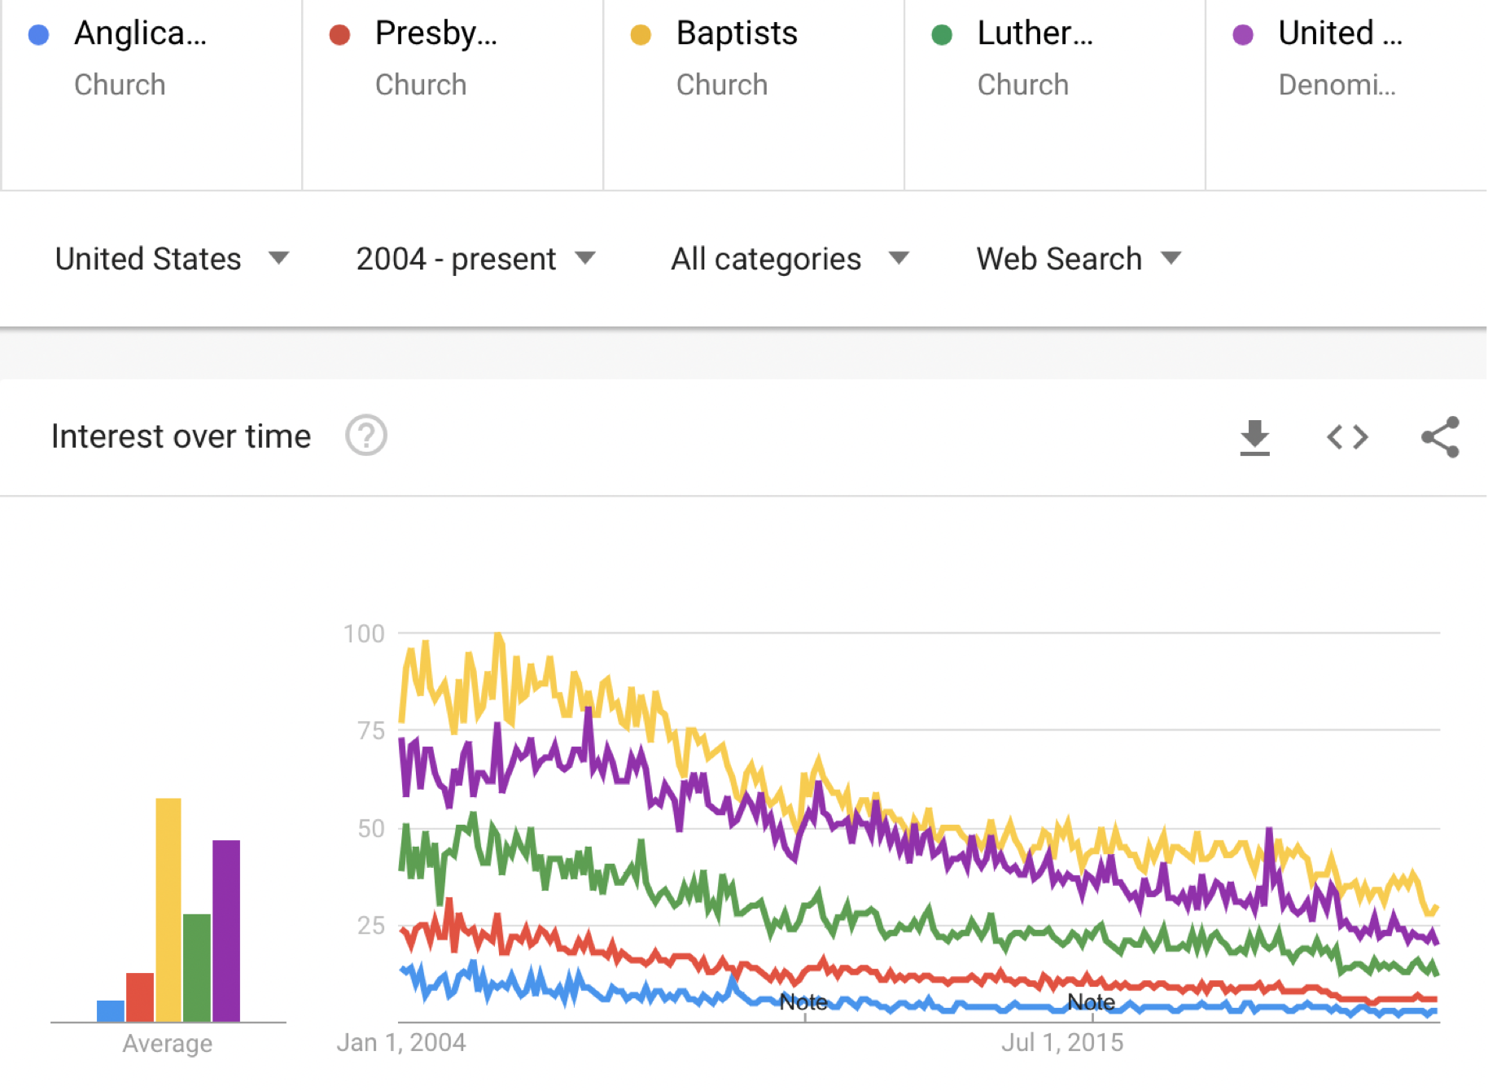
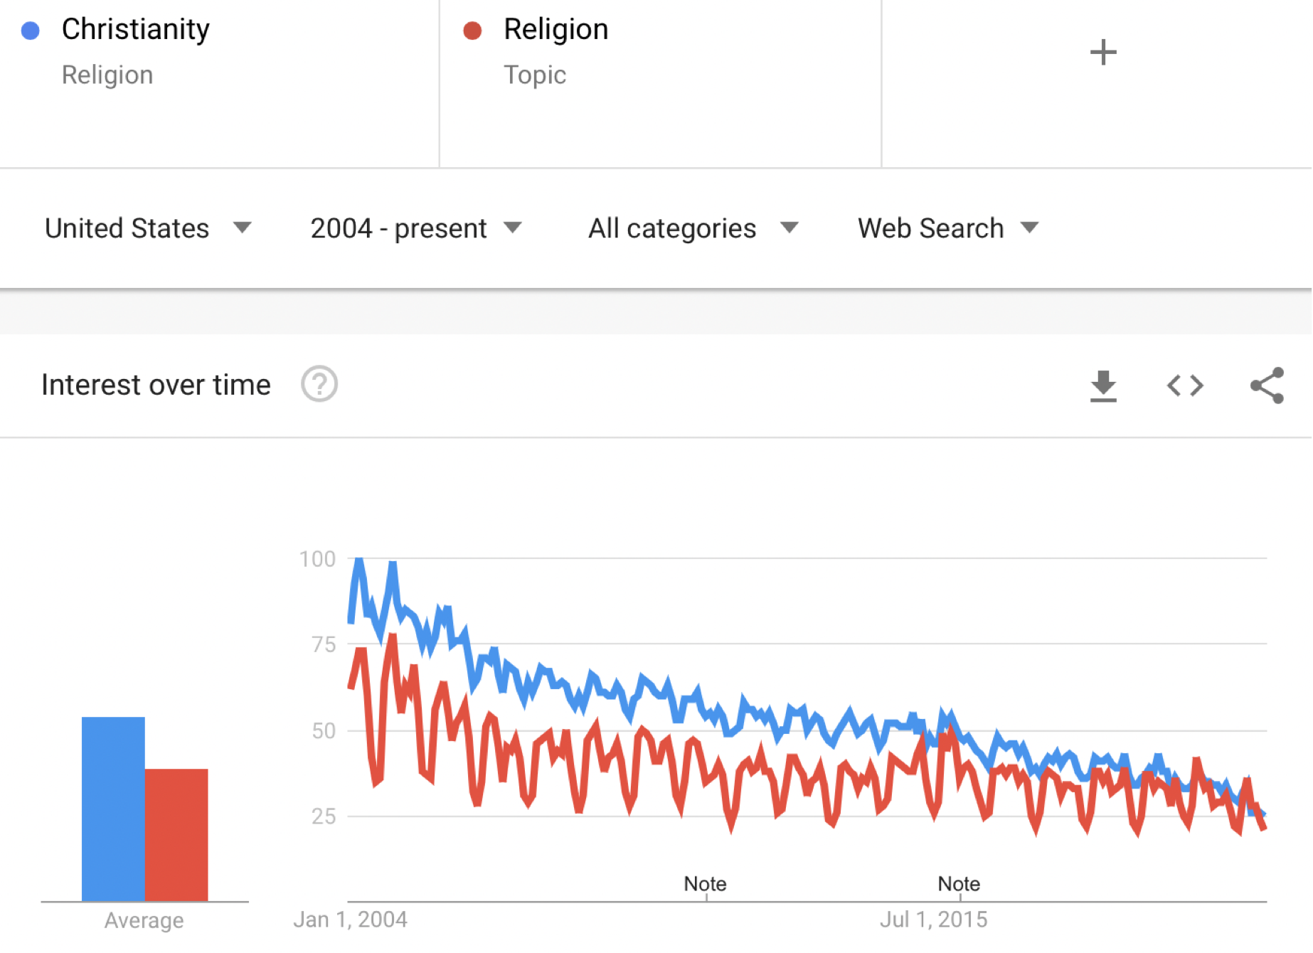
The downward shift in interest of popular Christian denominations
Christianity has several different denominations. Within the top ten most popular denominations are Anglican, Presbyterian, Baptist, Lutheran, and United Methodist. In the United States, Christianity, Religion, and all five of these denominations have trended downwards since 2004 on Google Trends. This supports the decline of organized Christian religion in the United States.

Slide 5
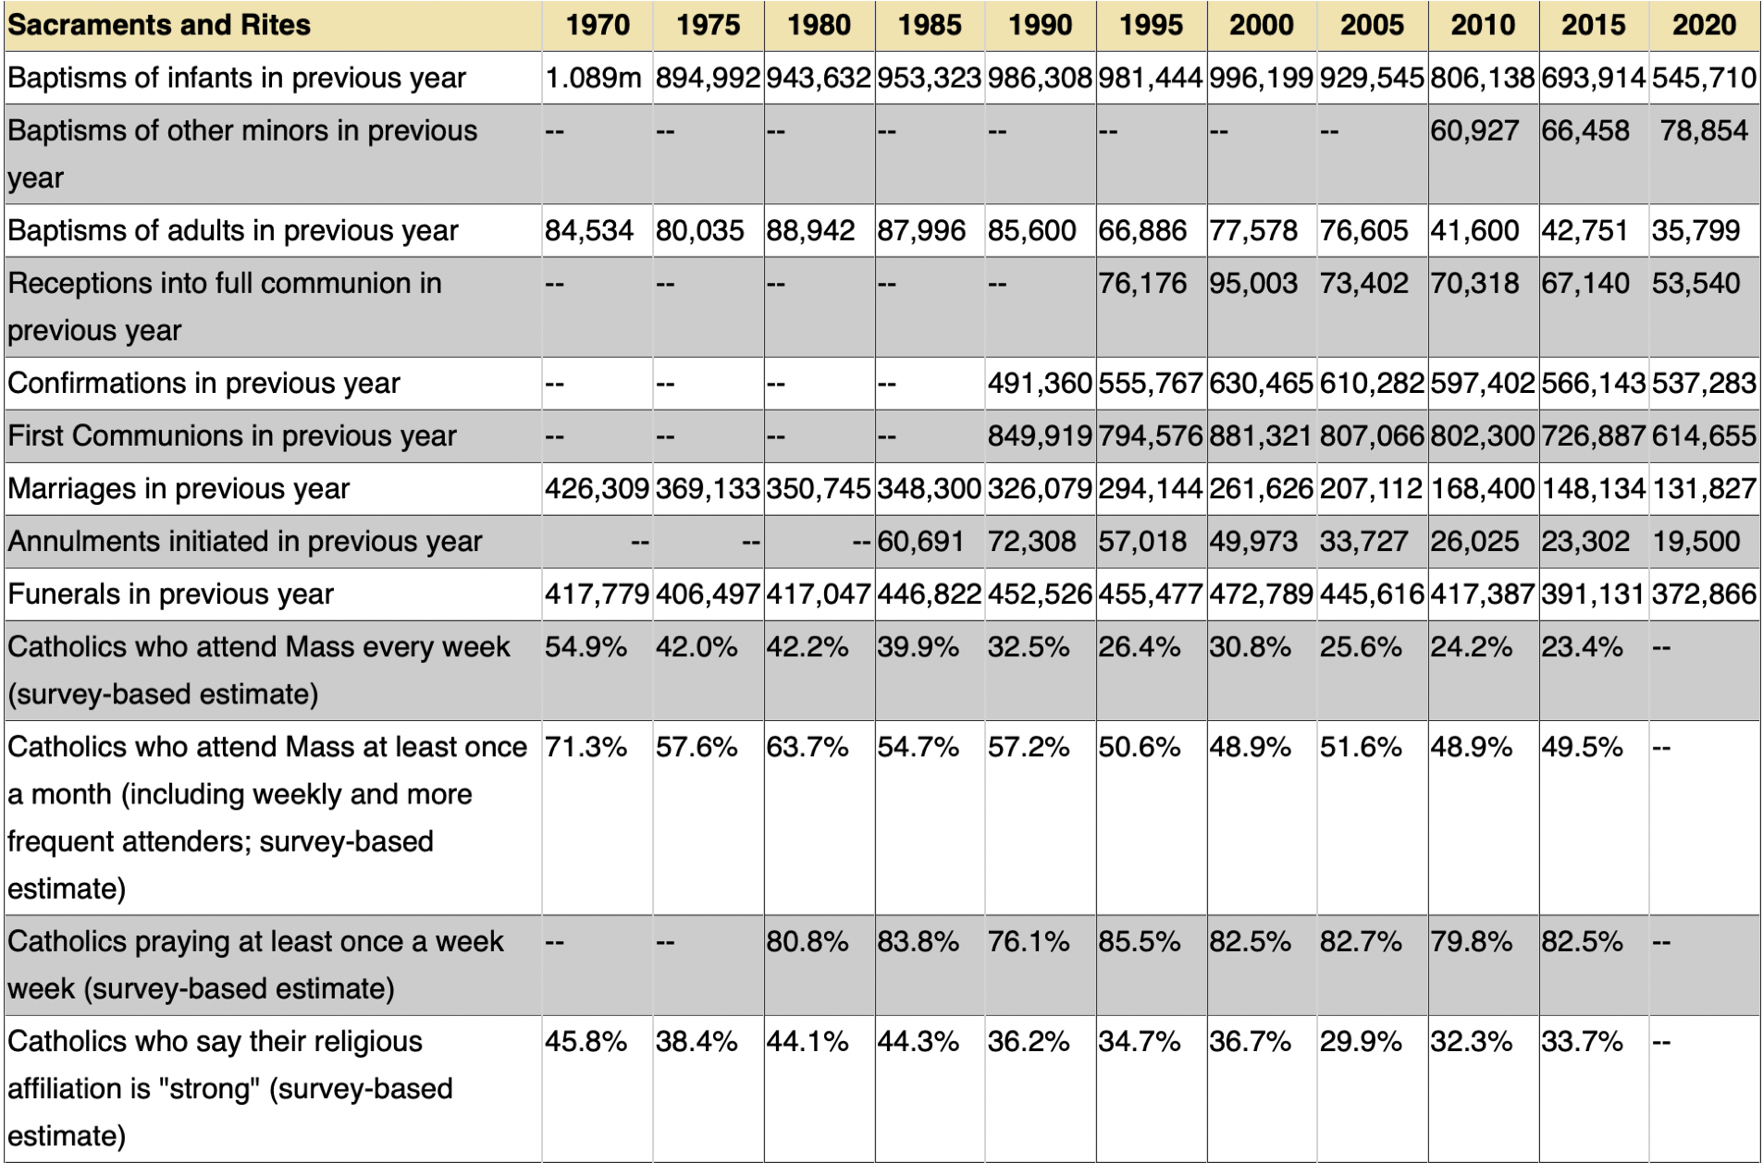
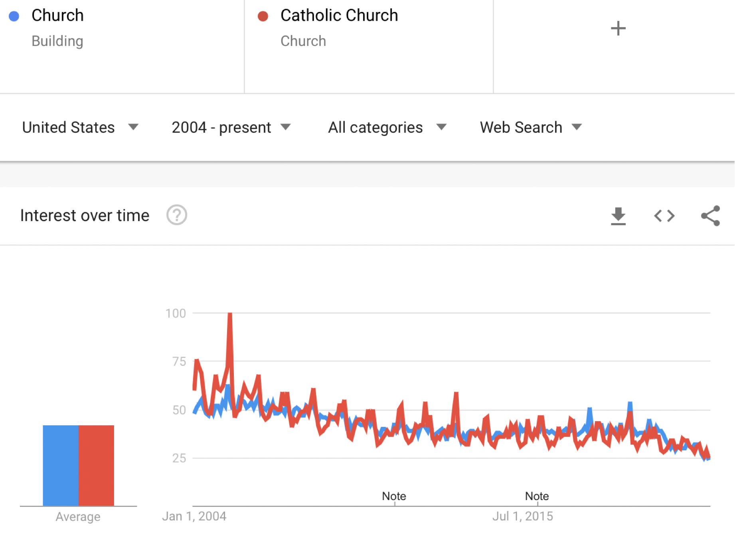
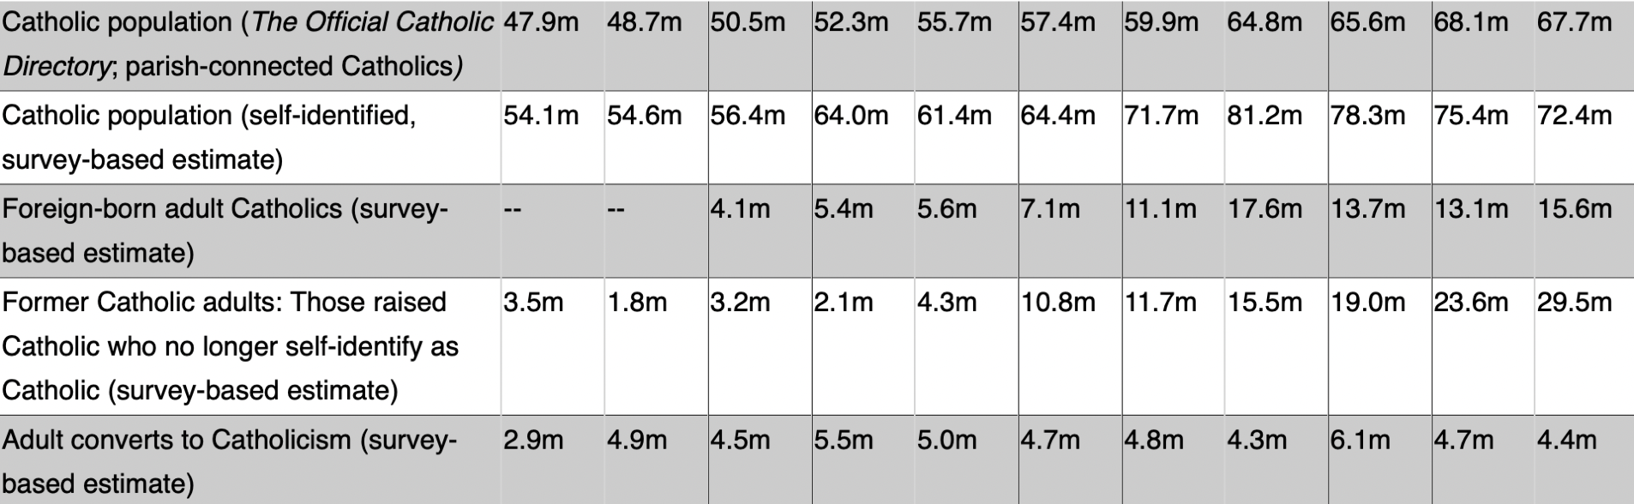
The catholic church
One additional popular Christian denomination is Catholicism. The topic “Church” as as well as “Catholic Church” show downward trends in Google Trends within the United States since 2004. Additional research provides statistics around Catholic Mass attendance every five years between 1970 through 2020. While the overall Catholic population increased, several statistics show a decrease in participation such as infant baptisms, first communions, marriages, and mass attendance. There has also been a large increase in former Catholic adults that have left the Catholic religion. This supports the decline of organized Christian religion in the United States.
This data was produced by the Center for Applied Research in the Apostolate showing Catholic survey data from 1970-2020.
https://cara.georgetown.edu/frequently-requested-church-statistics/

Slide 6
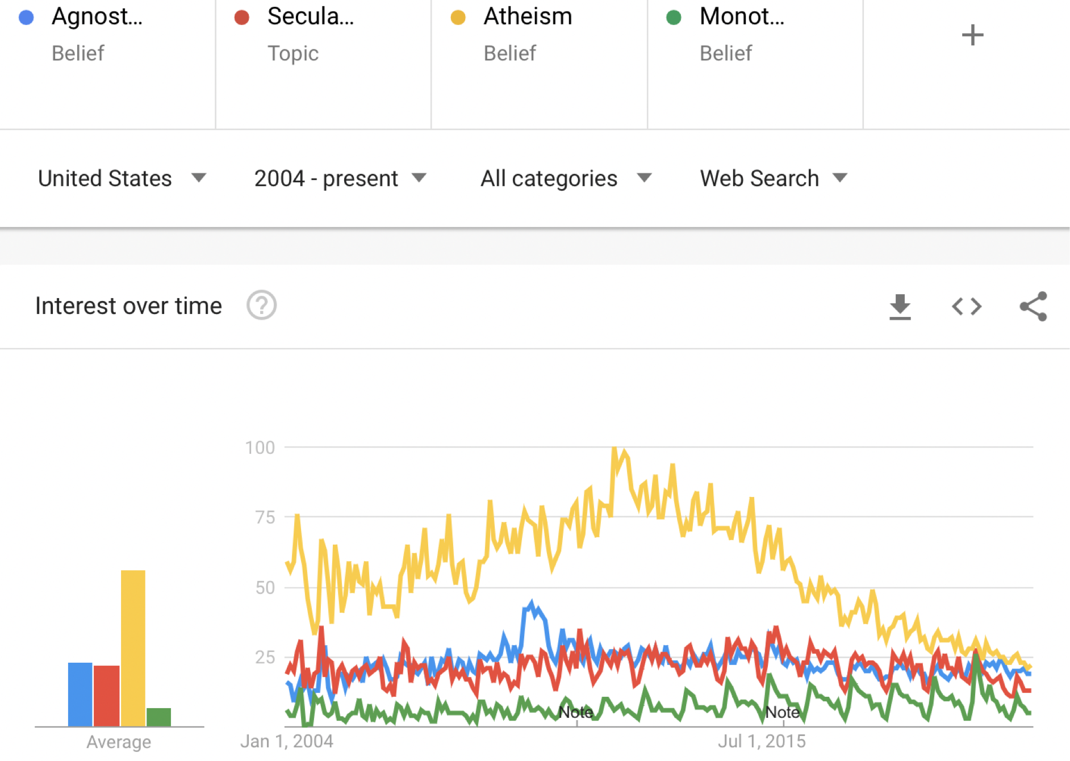
Non-Christian Beliefs
One can assume that if there’s a decline in Christian religion that there may be a negative correlation that shows an increase in other beliefs such as Agnosticism, Secularism, or Atheism. However, these beliefs have remained consistent or declined according to Google Trends since 2012. In addition, the belief of Monotheism has slightly increased, supporting that there is still a common belief in one God. This neither supports or disproves the decline of organized Christian religion in the United States. However, in conjunction with the previous slides this supports that while organized Christian religion is on the decline, the unaffiliated may still believe in Christ.

Slide 7
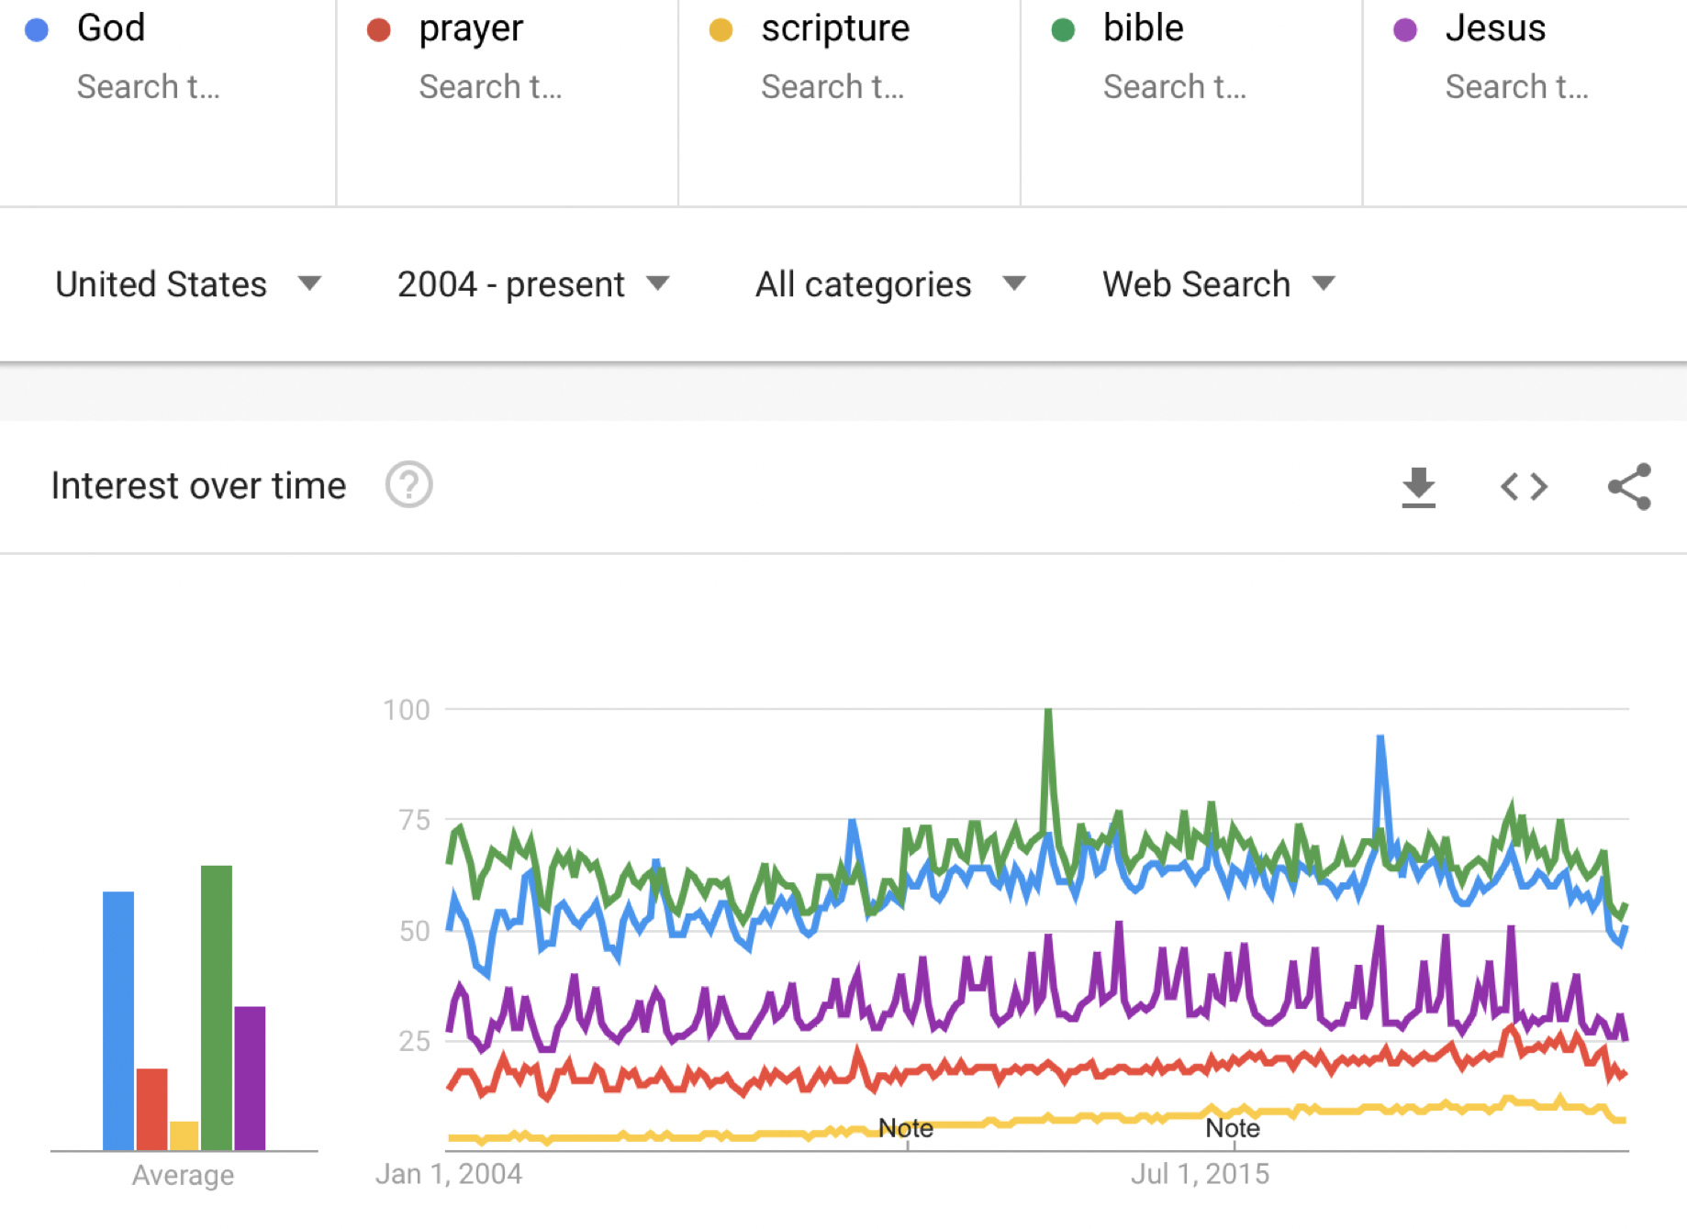
Interest in GOD remains constant
While Christian religious denominations and interest in church has trended downward, searches for God, prayer, scripture, bible, and Jesus have remained relatively constant since 2004 in the United States on Google Trends. This refutes the notion that the belief of Christianity is on the decline; however, it does not disprove that organized religion is on the decline.

Slide 8
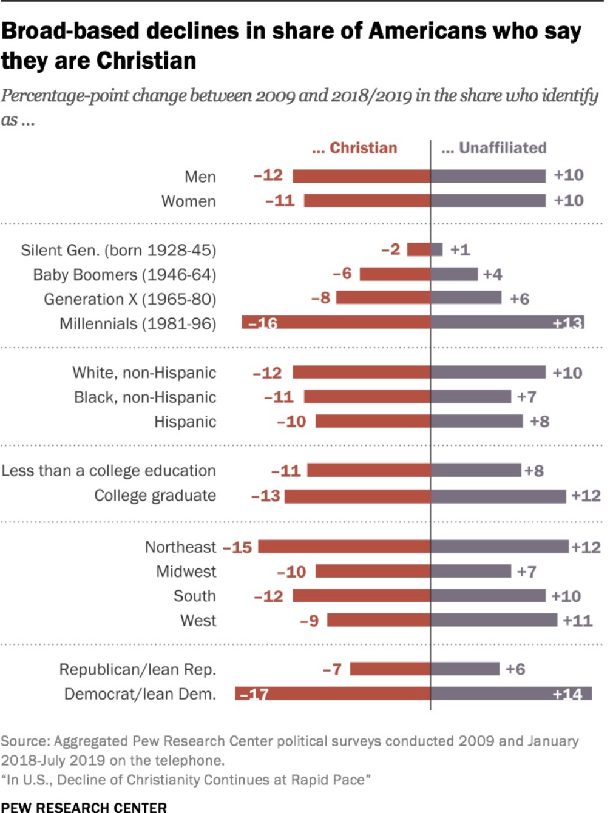
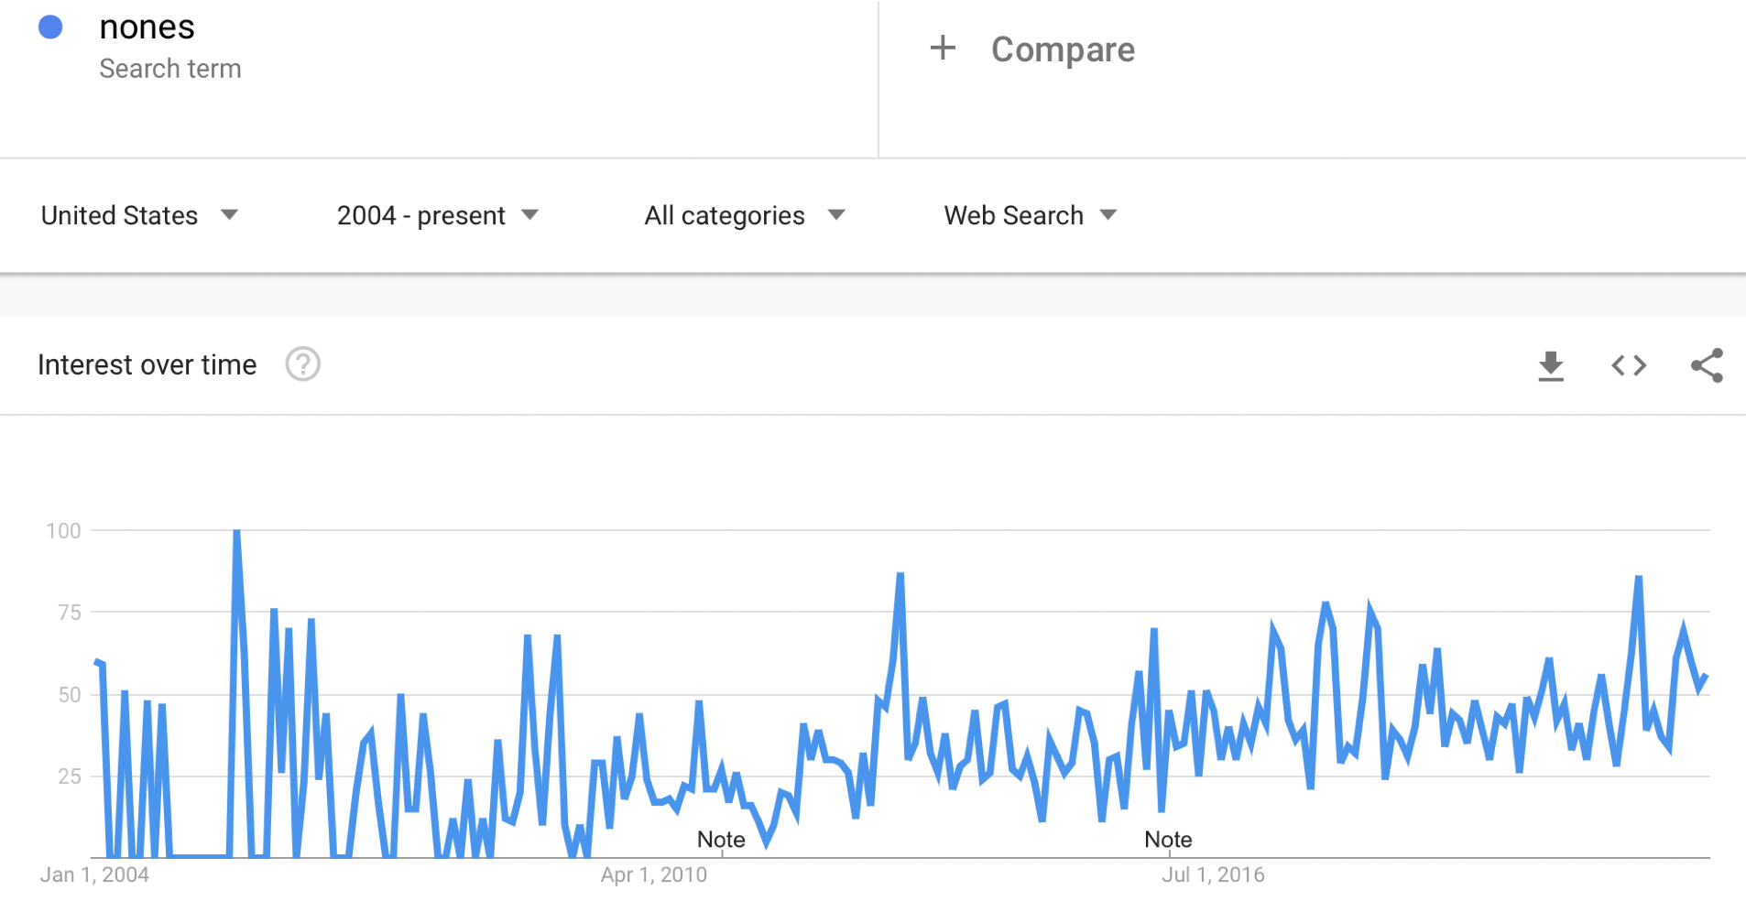
The nones
After further research, the term “Nones” describes the unorganized group of people who have no religious affiliation. This group is not very organized; therefore, there is not much of a presence in search criteria. The Google Trend below does show a slight increase in the search term nones. Other research statistics show the shift from Christian to Unaffiliated by various demographics. This supports the decline of organized Christian religion in the United States.

Slide 9
Other potential tests & Research topics
Most Christian religious church services are held on Sunday mornings. I would research grocery sales on Sunday mornings over time to see if more people are grocery shopping or shopping in general on Sunday mornings instead of attending church services. Another popular trend to explore is Sunday brunch attendance.
Social media is a great resource for data collection. I would research religious posts by age, location, gender, political party, employment, and religious affiliation. There may also be downward trends in physical social engagement due to a more virtual world. This would include participating as an active member in a church.
Those with stronger views towards topics such as gay rights and abortion rights may have conflicting views with Biblical ideals and find themselves at a disconnect with religion.

Slide 10
Conclusion
Based on these five methods of research, one can see that there is in fact a downward trend in the organized religion of Christianity. While it can be assumed there may have been a switch to non-Christian beliefs, this does not seem to be the case. There remains an increased interest over time in Christian related beliefs and terms. This discovery, paired with the increase in the “nones” and unaffiliated, leads to the conclusion that there are still strong Christian beliefs in the United States, but there is a disconnect with the organized Christian religion and church.

Slide 11

Ethical Concerns
Some of the supporting statistics in this presentation was based on survey data collection. When surveys are conducted there’s room for unintentional bias in samplings for surveys.
One ethical concern is the belief that religion is a significant contributor to developing one’s moral compass. Without organized religion, there is an assumption that the standard for what the masses consider “ethical” could slowly shift over time towards a direction that is portrayed as unethical in current times.

